Slide 1


ROCK PAPER SCISSORS
A Simple, lightweight game developed by MOHIT PARYANI

Slide 2
Game features
Single-player game
Keep track of your scores
Responsive design and UI available for pc and smartphones
Single page architecture

Slide 3
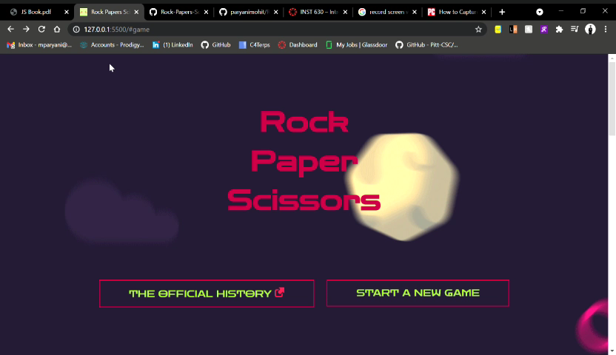
Header interface

Slide 4
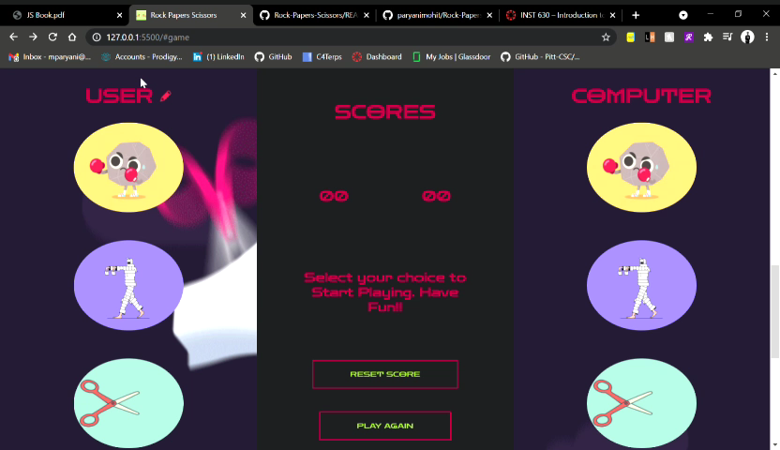
game interface

Slide 5
Chapters & features

Slide 6
Chapter-1
Write external JavaScript file
Use HTML with CSS and JavaScript
Chapter-2
Store Username into one of the declared variables in JavaScript file
Used concept of Arithmetic operators for developing the Game logic

Slide 7
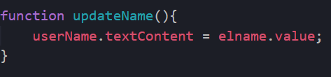
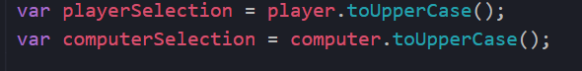
Chapter-3
Created Functions for different functionalities
Used String object methods for the Game logic
Used Math object method to develop Game Logic

Slide 8
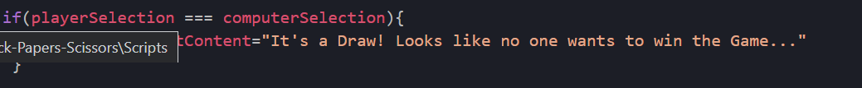
Chapter-4
Used Conditional Statements to decide the winner of the game
Used Logical OR for selecting conditions for winning
Chapter-5
Access the elements in the DOM tree and work with them
Used .getElementById to fetch Elements by ID and store in the variables

Slide 9
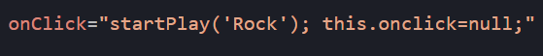
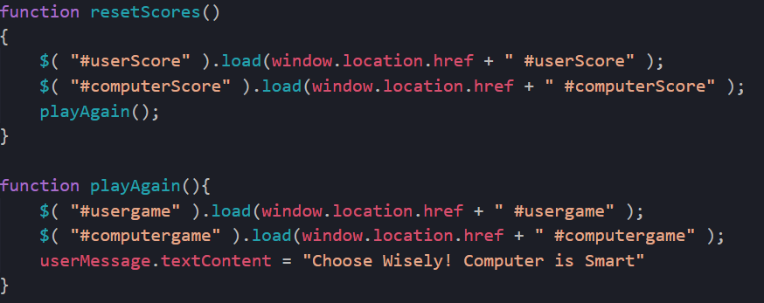
Chapter-6
Used :onClick event to trigger the Game when clicked on images
Chapter-7
Used jQuery for Reset Score and Play Again button

Slide 10
DEMO

Slide 11
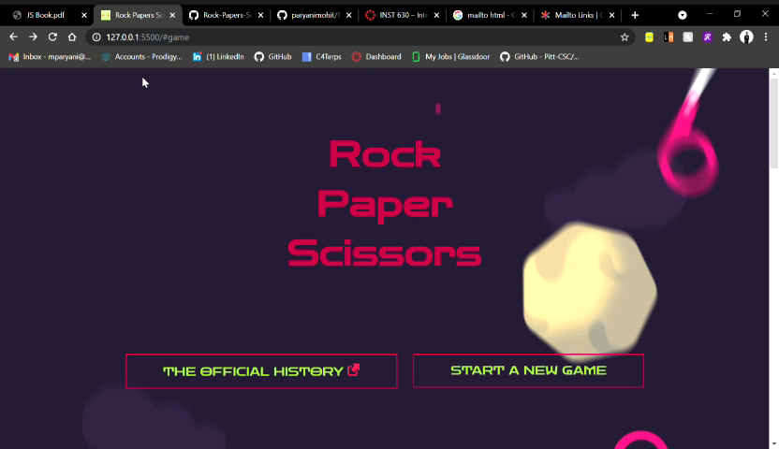

Slide 12

Thank you

